Slide 1

Ivirtualoffice.biz
-training presentation

Slide 2
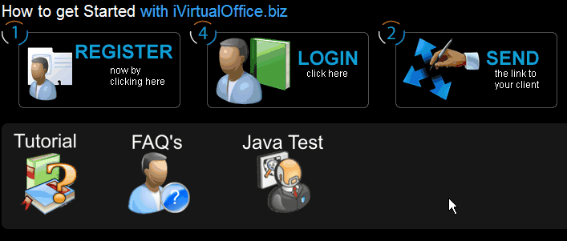
Register
www.ivirtualoffice.biz
Scroll to bottom of page; click java test
If your machine is not ready go to java.com and download the newest version of java.
If you’re ready go back to the homepage and click the register button
Enter your information
Click submit

Slide 3
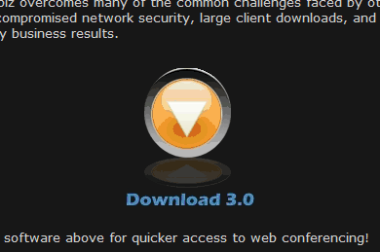
Download
www.ivirtualoffice.biz
Center of page click download V3.0
Install

Slide 4
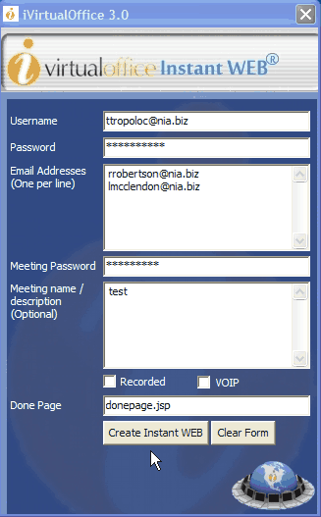
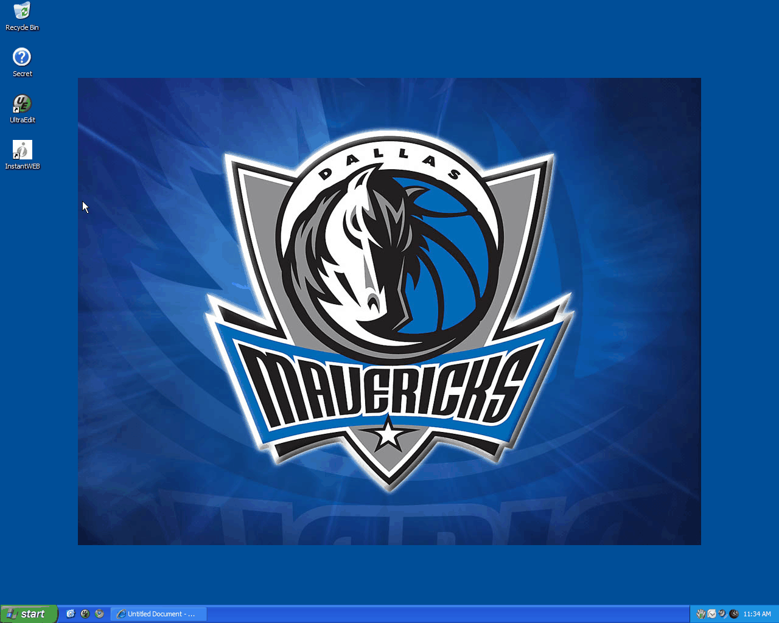
Launch
Click your Instant Web icon on your desktop.
Enter in the information that relates to you.
Enter in as many email addresses that you would like to.
Make sure to only have one address per line.
Click create Instant web.

Slide 5
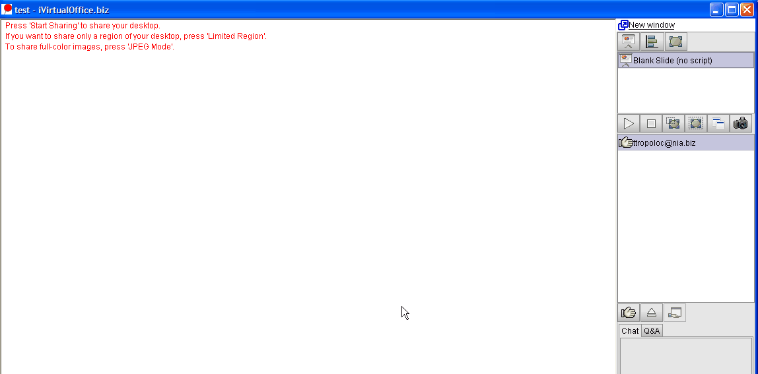
Remember
Once the program loads make sure to click the camera button, and then click the play button to share your screen with the client.
2
1

Slide 6
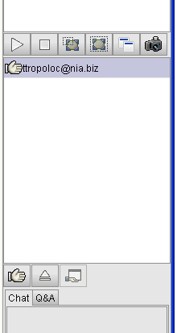
Share Control
To share control with a client click on there name one time.
Then click the hand holding the screen button below the list of participants.
The participant you selected will receive a pop-up asking if they would like to take control.
Once that has been started they
are in charge of your computer.

Slide 7
Make Moderator
Same steps as Share Control except instead of selecting the hand holding the program, select the large hand and make them the Moderator.
Now they are in charge and have full control over the session.

Slide 8
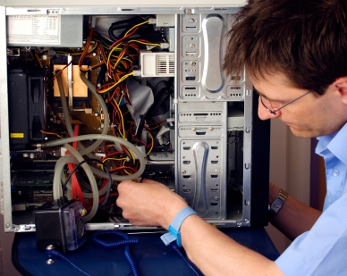
Troubleshooting
Ivirtualoffice is java and web based platform.
If you or a potential client is having problems close out the program and go in to your internet explorer. Click tools. Then internet options. And select delete. Select cookies, and cache.
Restart the program.

Slide 9
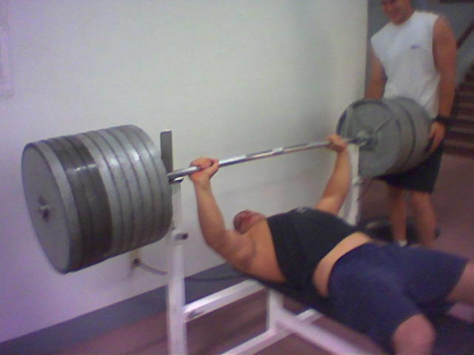
Need more help?
Email Me: ttropoloc@nia.biz
Subject: IVO HELP!

Slide 10

Congratulations!!
You’re ready to use now!

